Slide 1
Note to instructors
You are welcome to use these slides in your course materials.
Feel free to modify to meet course needs.
We are always interested in providing more instructor support, feel free to email us at: info@clinicalcareclassification.org
This slide-deck was last updated October 4th, 2026.

Slide 2
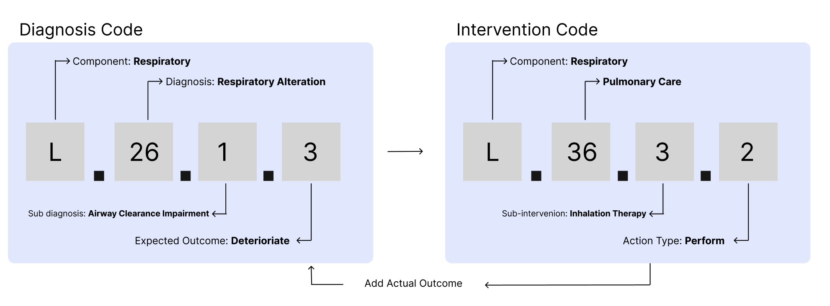
Introduction to the Clinical Classification Care System (CCCS)
Outline
Three reasons to use the CCCS
Highlights
History
Information Framework
Information Model
Visual Representation of Codes
In Practice
Key Take-aways

Slide 3
Three Reasons to Use the CCCS
It helps with communication
  It provides nurses with a common set of definitions to describe the patient experience.
  These definitions are specific to the nursing process.
It helps with decision support
  Care-plans can be automatically generated based on Nursing Diagnosis.
  EMRs can provide alerts and guidance based on Nursing Diagnosis and changes in patient status.
It helps show the impact of nursing
  When combined with intervention and outcome codes, quality improvement projects can see what works best.

Slide 4
Highlights of CCCS
Developed by nurses for nurses
Open-access, no fees
More than just Diagnosis Codes! Also lets you link interventions with outcomes
Uses six-steps of the Nursing Practice
Free mapping to other terminologies (SNOMED CT, LOINC and 3MMM)
Notes:
Omaha

Slide 5

History of CCCS
Started at Georgetown University School of Nursing in 1988 with research led by Dr. Virginia Saba
Chart abstractions of 8,961 patient encounters across national sample of 646 healthcare facilities.
Statistical analysis produced standardized coded terminology for assessing, documenting and evaluating nursing care
Formally recognized in 1991 and reaffirmed in 1998 and 2006 by the ANA
Today it has been mapped to other terminologies, translated into 19 languages, and freely used around the world.

Slide 6
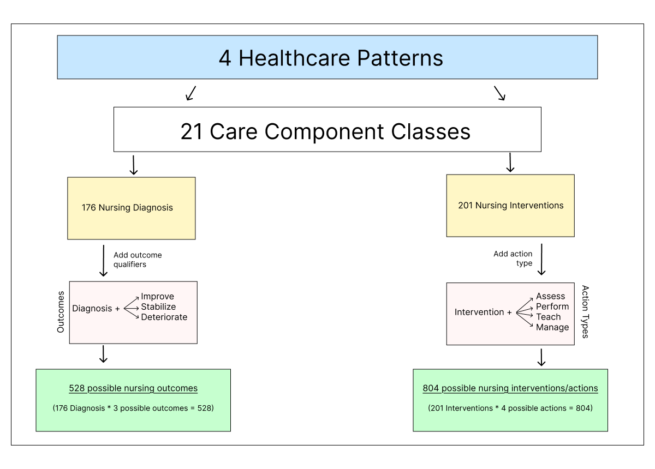
About the CCCS Information Framework
Four levels make it possible to code the concepts for each level separately so that the coded data can be aggregated upward for summary information or parsed downward to view the atomic level data elements.
Notes:
For more information, see: https://clinicalcareclassification.org/framework/

Slide 7
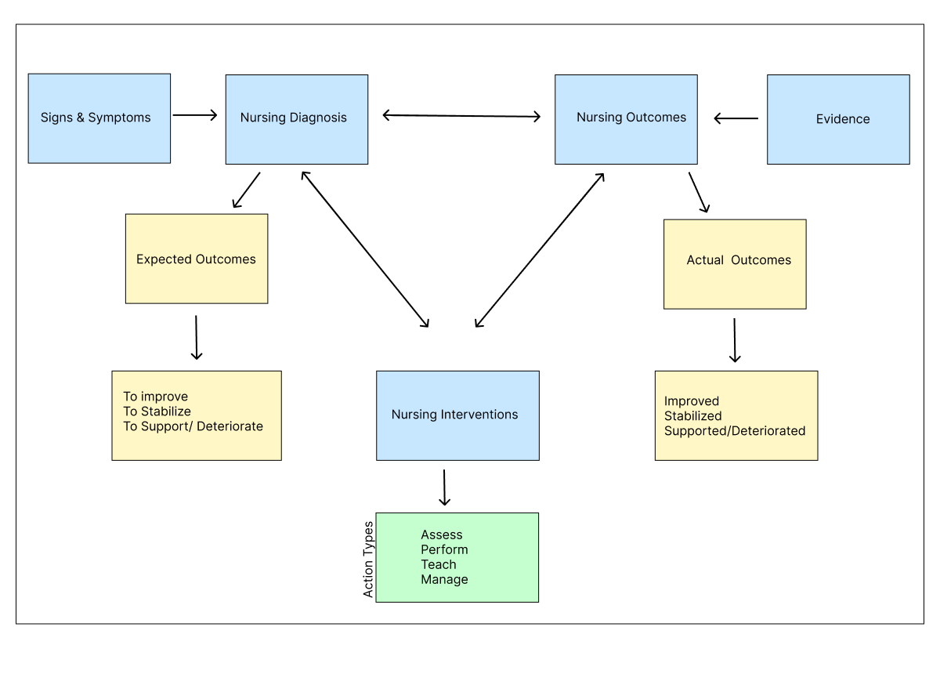
The CCC Information Model Illustrates:
The flow of nursing knowledge
Relationship between diagnosis and outcomes, and interventions and actions
Continuous flow and feedback
Notes:
For more information, see: https://clinicalcareclassification.org/framework/model/

Slide 8
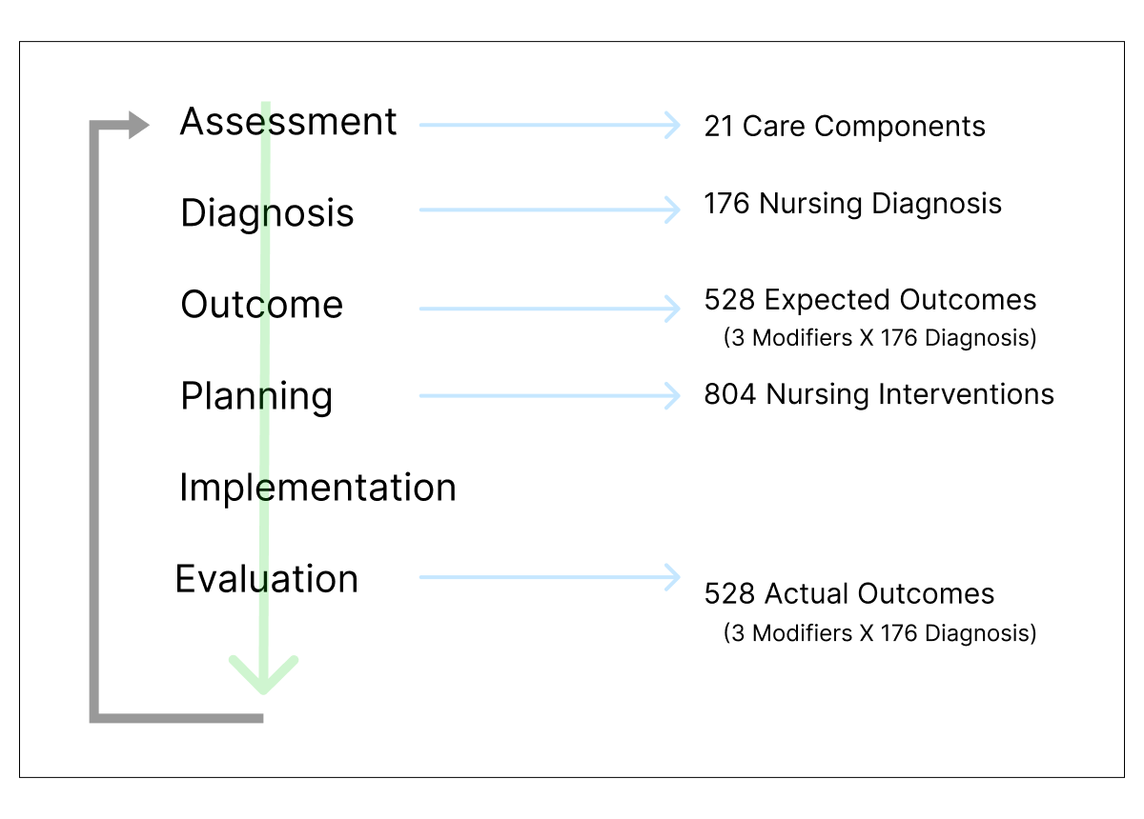
CCCS and the Six Steps of the Nursing Process
Use the CCCS to code and classify the six steps/standards of the ANA nursing process
Notes:
For more information, see: https://clinicalcareclassification.org/framework/components

Slide 9
Visual Representation of Diagnosis and Intervention Codes
Notes:
Five digit alpha-numeric codes are used to store diagnosis codes (including expected outcomes) and intervention codes (including action types).
After interventions are completed, the actual outcome can also be stored in the database.
Generally vendors use pick-lists and drop-downs so that nurses can browse through code labels without having to memorize or actually see the alpha-numeric code.

Slide 10
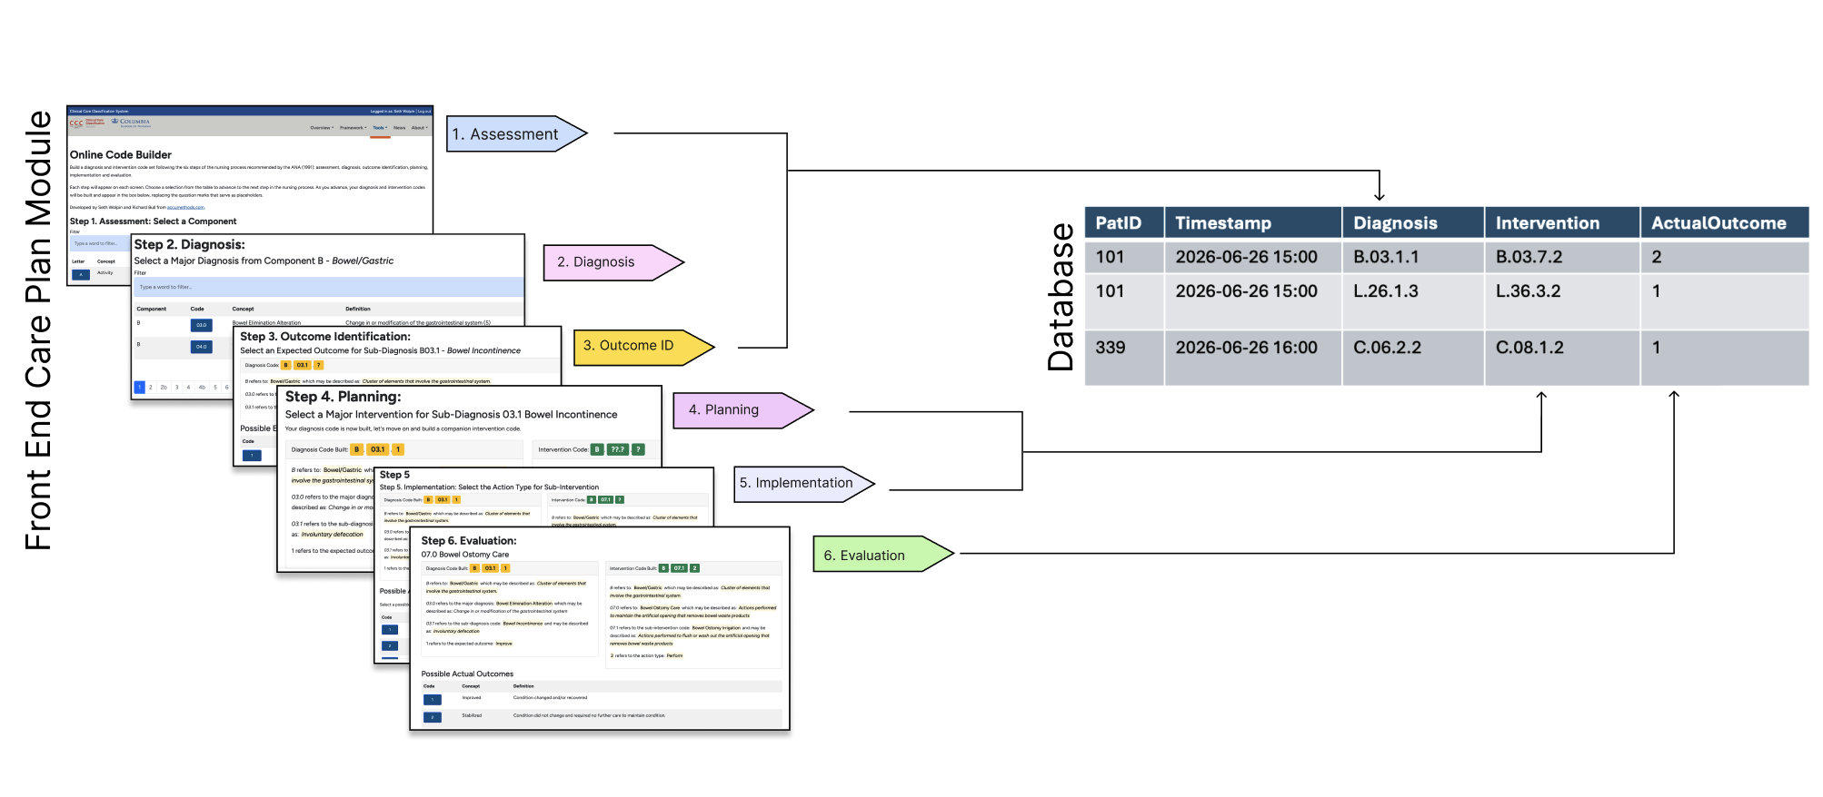
What it looks like in Practice
EMR Database Representation (simplified)
PatID | Timestamp | Diagnosis | Intervention | ActualOutcome
101 | 2026-06-26 15:00 | B.03.1.1 | B.03.7.2 | 2
101 | 2026-06-26 15:00 | L.26.1.3 | L.36.3.2 | 1
339 | 2026-06-26 16:00 | C.06.2.2 | C.08.1.2 | 1
Notes:
Nurses don’t have to memorize codes. EMR and software vendors can integrate the CCCS to use human readable drop-downs and pick-lists showing code names, labels, descriptions and the
Actual alpha-numeric codes can be stored in the EMR database.
The CCCS website includes an easy to use ‘Code-Builder’ that follows the six steps of the nursing process.

Slide 11
Key Take-aways about the CCCS
Is an open-source nursing terminology with no licensing fees
It was created by nurses for nurses using a research process
It is recognized by the ANA
Users can link nursing diagnosis and nursing interventions, showing the value of nursing care.
When implemented into the EMR, users can use drop-downs and pick-lists to assign diagnosis and interventions without needing to memorize or navigate the underlying codes
It has been widely adopted around the world

